Slide 1
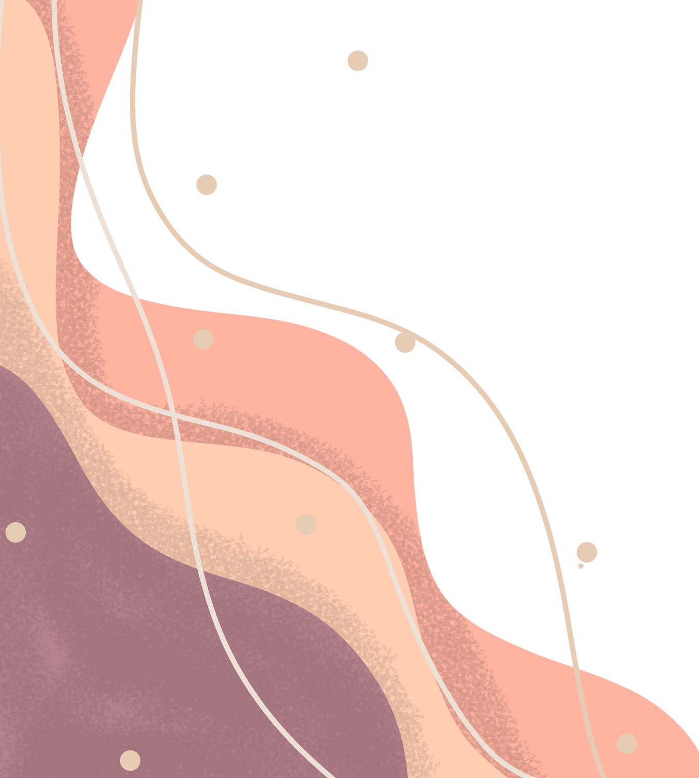
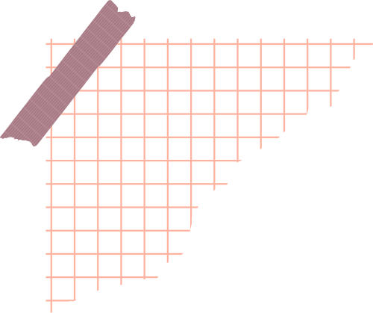

AI Based Hand Gesture Recognition using Python
Presented by Group 7

Slide 2
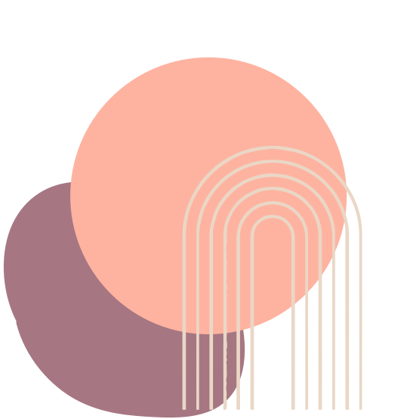
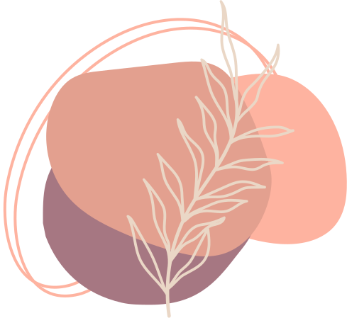
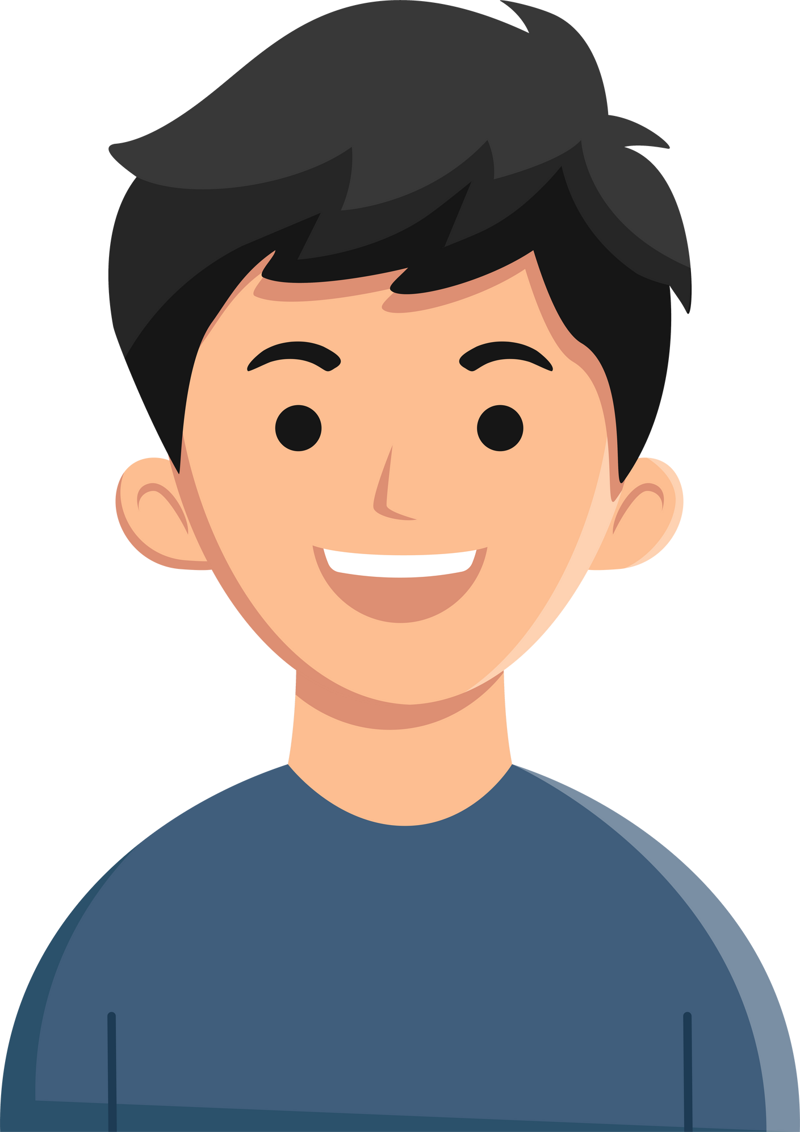
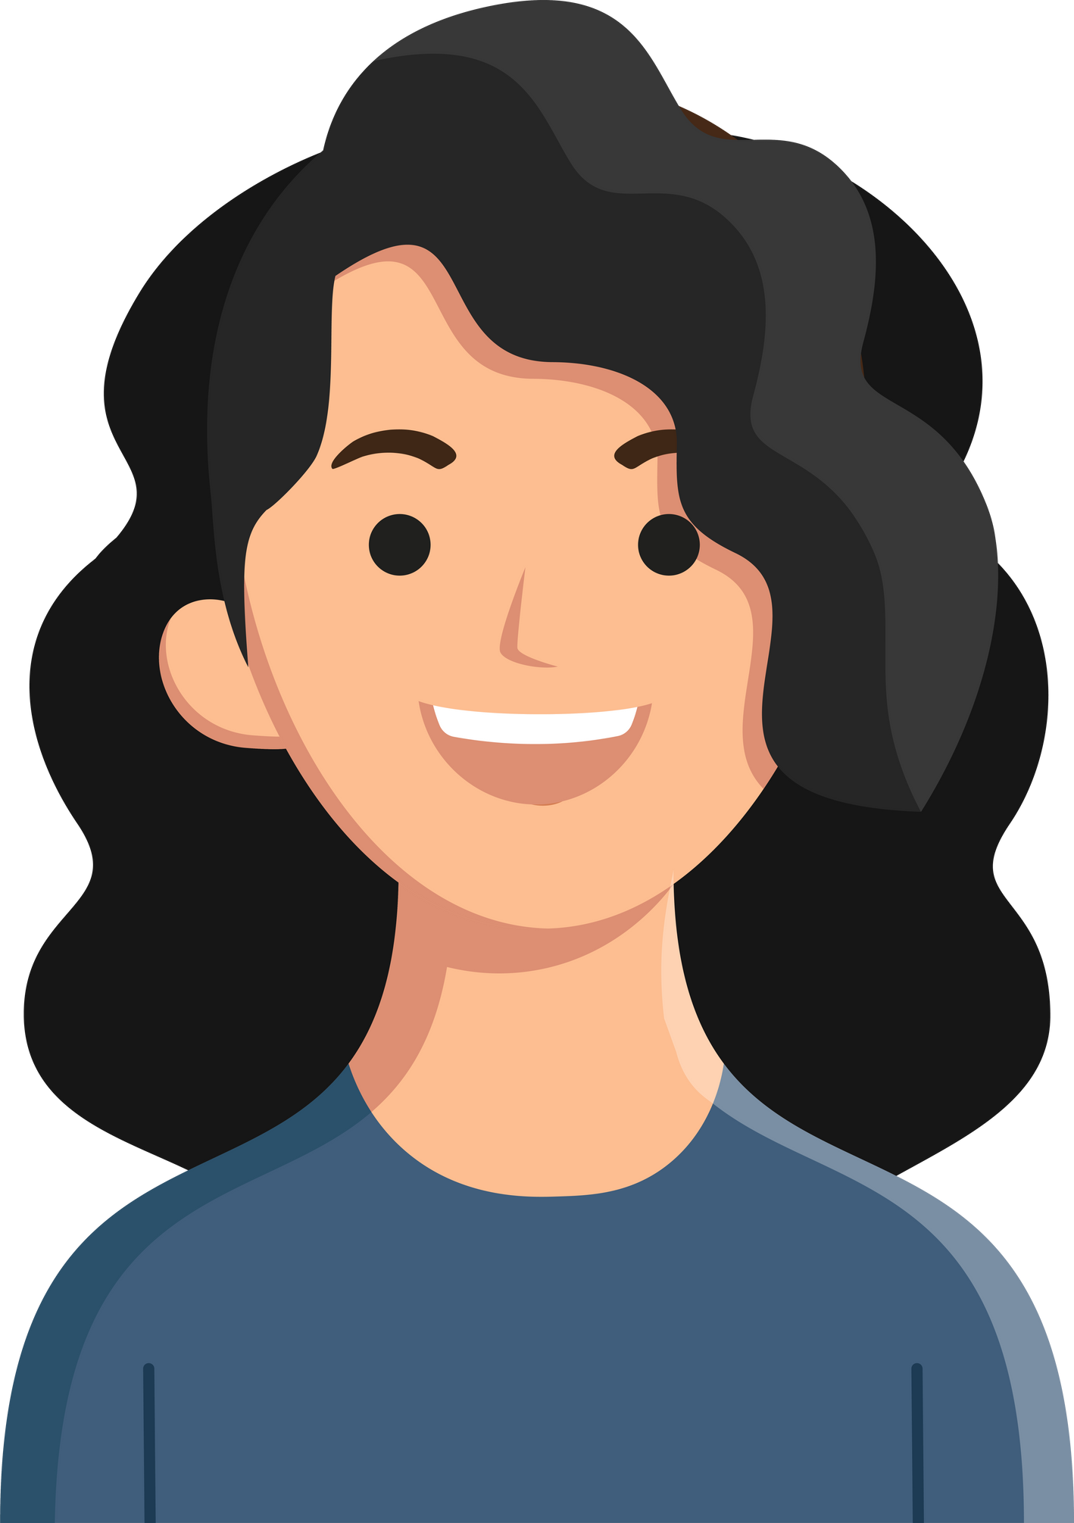
Our Team
Rohan
Mukund
Shrey
Poorvi

Slide 3
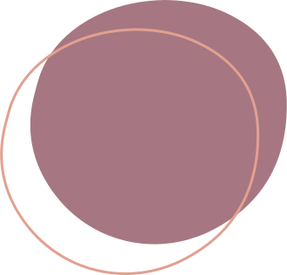

About
Gesture-based interfaces are systems that allow users to interact with them by using hand or other body components. These applications are getting more and more popular and have a wide range of use cases; for example in home automation, healthcare, automative, virtual reality, etc. If well designed, gesture-based interfaces feel more natural, intuitive and easier to learn.

Slide 4


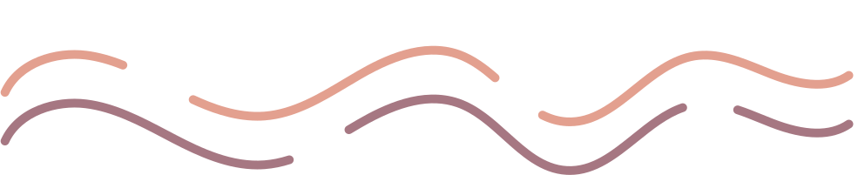
Project Goals
1
Scope: Implement AI-based hand gesture recognition
2
Enhances human-machine interaction.

Slide 5
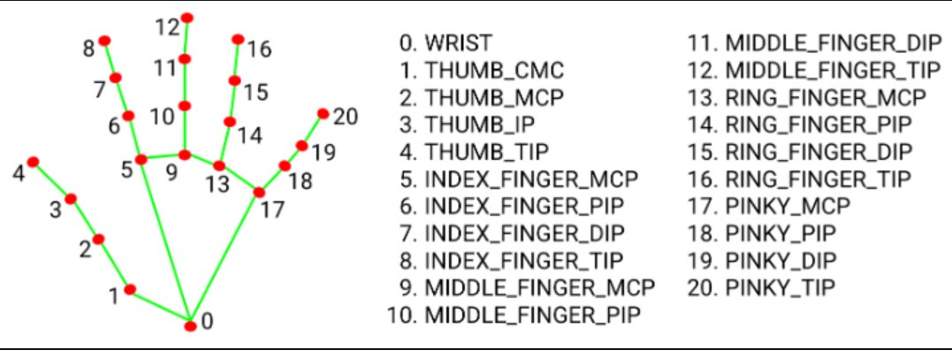
End Goal
The goal of this project is to use an Artificial Neural Network to recognise a set of hand gestures and use those to interact with any desired software like YouTube player. Additionally, if the user is sleeping or has left, the player will get paused automatically. Here

Slide 6
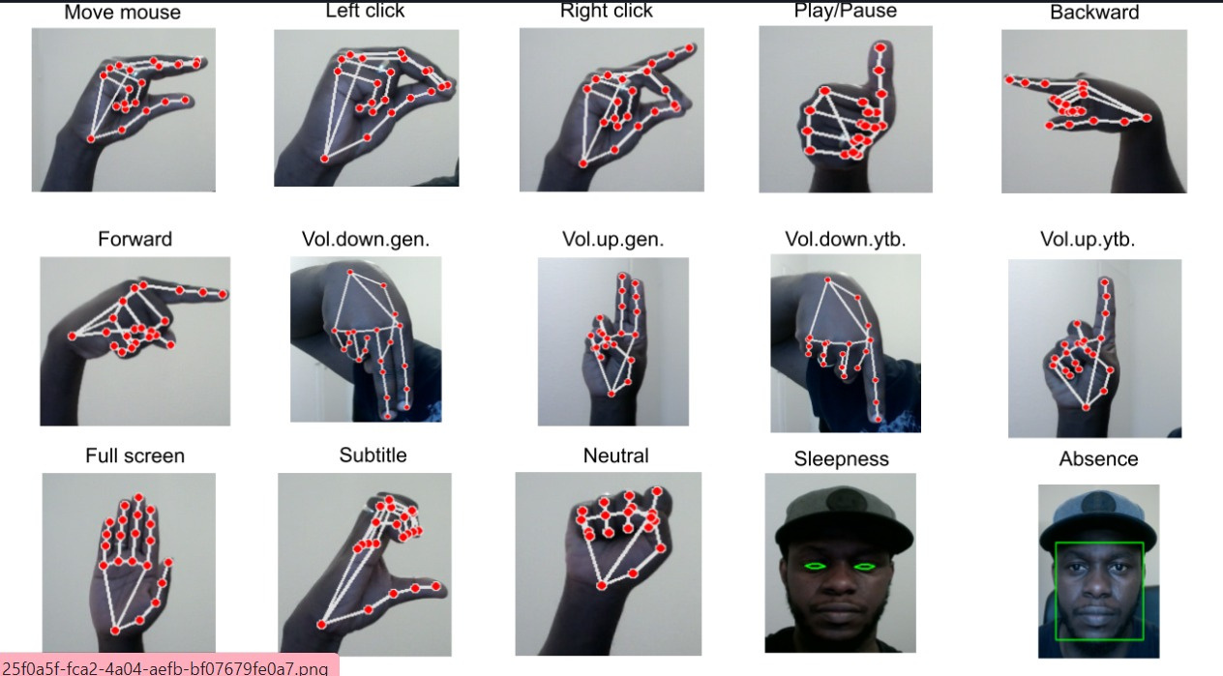

Slide 7


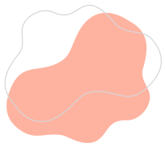
Background and initial process
Firstly a gesture is identified in each frame and then classified. We also created a count function that helped us count the number of times a gesture was performed and help us analyse these talks in a better way. Two experimental studies were carried out to analyse viewer engagement: one, the effect of suitable gestures on the viewer count, and secondly, suitable gestures on the sentiment of the viewer. Interesting results are observed that suitable gestures from talkers have an impact on increasing positive review and viewer count.

Slide 8
One of the Main Application
YouTube Playback Control: Once the application recognizes a specific hand gesture, it triggers the corresponding action for YouTube playback control. For example, if the "v_up" gesture is detected, it increases the volume; if "max" is detected, it enters fullscreen mode; if "stop" is detected, it pauses or resumes the video, and so on. These actions are simulated using the pyautogui library, which emulates keyboard inputs

Slide 9
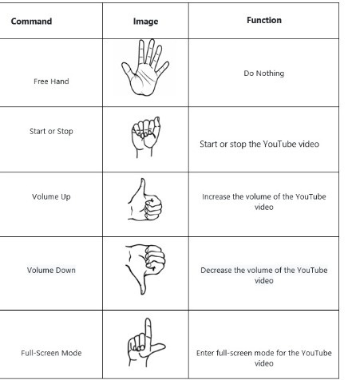
One of the Main Application

Slide 10
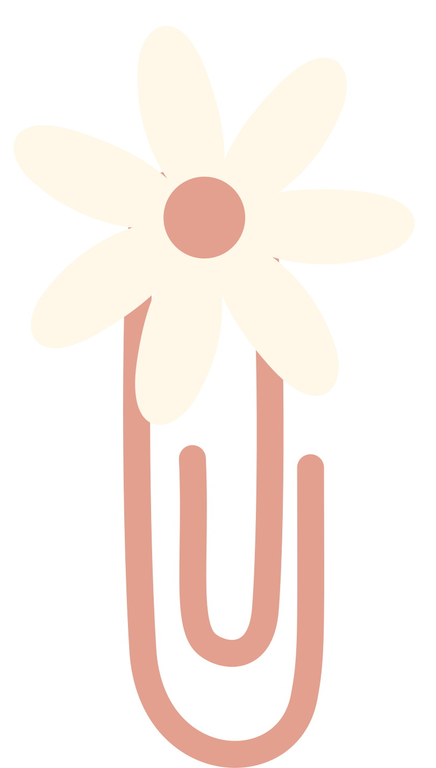

For the initial stage respective people are training for the respective models
Different hand models to train
Volume Up and Volume Down (Shrey)
Forward and Backward (Rohan)
Pause and play (Poorvi)
FullScreen and Minimize (Mukund)

Slide 11
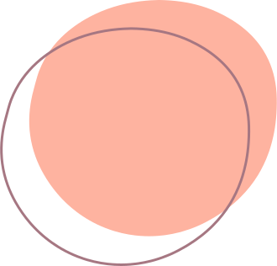
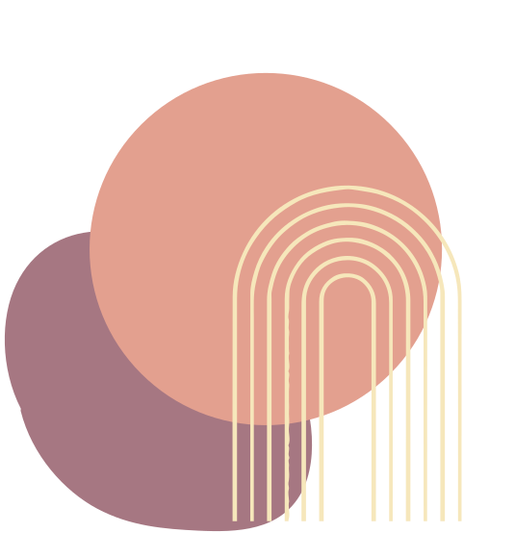
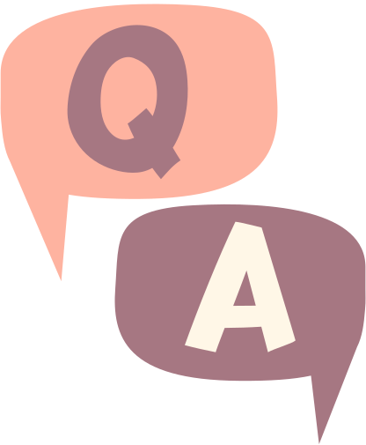
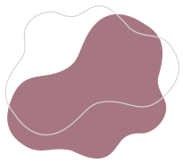

Slide 12


